Slide 1

Rationale
Introduction to Windows Store App Development Using HTML5 and JavaScript
Computer science is a field of study that deals with solving a variety of problems by using computers.
  To solve a given problem by using computers, you need to design an algorithm for it.
Multiple algorithms can be designed to solve a particular problem.
An algorithm that provides the maximum efficiency should be used for solving the problem.
  The efficiency of an algorithm can be improved by using an appropriate data structure.
Data structures help in creating programs that are simple, reusable, and easy to maintain.
This module will enable a learner to select and implement an appropriate data structure and algorithm to solve a given programming problem.

Slide 2
Objectives
  In this session, you will learn to:
  Use data templates for displaying data
Notes:
2

Slide 3
Using a Data Template for Displaying Items in a UI Element (Contd.)
Let us look at an example, which demonstrates the use of data template in an app
Notes:
3

Slide 4
Using a Data Template for Rendering HTML Content
  To render HTML content by using a data template, you can use the render() function of the WinJS.Binding.Template object, which represents a data template.
  The render() function:
  Binds data from the specified data context with the UI elements, which are descendants of the specified container element.
  Has the following syntax:
    <templateControlName>.winControl.render
    (<dataContext>, <containerName>);
Notes:
4

Slide 5


Just a Minute
  Identify the syntax that is used to display the content of the data source by using the myCustomDataTemplate object.
    1. myCustomDataTemplate.render()
    2. myCustomDataTemplate.winControl.render()
    3. myCustomDataTemplate.winJS.render()
    4. myCustomDataTemplate.WinJS.WinControl.render()

Slide 6
Just a Minute (Contd.)
  Solution:
    2. myCustomDataTemplate.winControl.render()

Slide 7
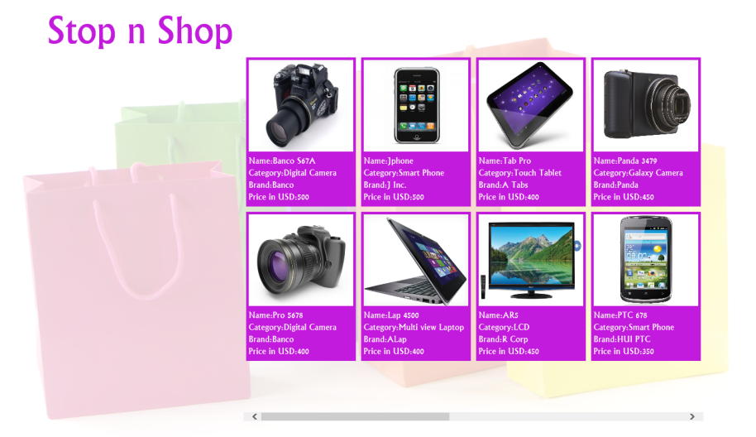
Demo: Using Data Template for Displaying Data
  Problem Statement:
    Ryan, a Windows Store app developer, is assigned a new project of developing a Shopping portal app for a company that manufactures electronic items. The app contains the information for all the products that the company manufactures. Ryan needs to display a list of all the products on the Home page of the app, as shown in the following figure.
Notes:
7

Slide 8

Demo: Using Data Template for Displaying Data (Contd.)
    When a user selects a product from the list, its corresponding details are shown on the Product Details page, as shown in the following figure.
    As an initial step, he designs the UI of the app, which is made up of two pages, Home page and Product Details page.
    Help Ryan implement the required functionality in the app.
Notes:
8

Slide 9
Demo: Using Data Template for Displaying Data (Contd.)
  Solution:
  To enhance the preceding app, Ryan needs to perform the following tasks:
    1. Define the data source.
    2. Bind UI elements with data source.
    3. Implement navigation.
    4. Display the details of the selected product.
    5. Execute the app and verify the output.
Notes:
9

Slide 10
Summary
  In this session, you learned that:
  To render HTML content by using a data template, you can use the render() function of the WinJS.Binding.Template object, which represents a data template.
Notes:
10

Slide 11
What’s Next?
  You need to perform the following exercises of IWSADHJ Chapter 4 in the MR session:
  Exercise 1
  Exercise 2
  Exercise 3
  In addition, you need to perform the following exercises of IWSADHJ Chapter 5 in the MR session:
  Exercise 1
  Exercise 2

Slide 12

Q&A

